Slide 1
Lecture 12: Machine Learning III Learning Ensembles
DS 503: Advanced Data Analytics
Based on lecture slides for Stanford CS226, Harvard CS109
Data Mining Book etc.
Instructor: Dr. Gagan Raj

Slide 2
Today’s Class: Ensembles Motivation
Imagine a team of engineers working on solving a problem
Each of them have different strengths and together they can do better
This is roughly the motivation in building the ensemble of ML models
If we have multiple weak classifiers, can we expect their combination to do better?
Yes, if they are good in different areas. We combine their predictions
Combination of learners to increase accuracy and reduce overfitting.
Main causes of error in learning: noise, bias, variance. Ensembles help reduce those factors.
Improves stability of machine learning models.

Slide 3
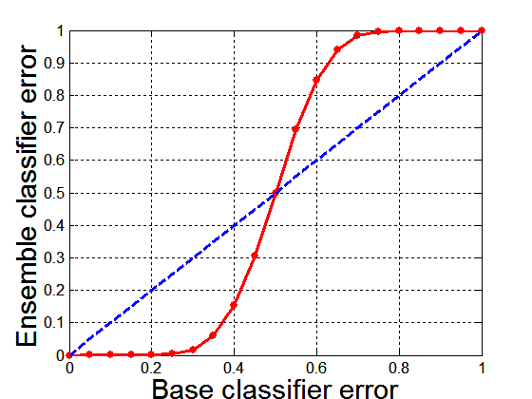
Why Ensemble Methods work?
Suppose there are 25 base classifiers
Each classifier has error rate, ε = 0.35
Assume errors made by classifiers are uncorrelated
Probability that the ensemble classifier makes a wrong prediction:

Slide 4
General Approach
Classifiers are independently learnt over independent samples of the training data
Predictions are averaged or a majority vote is taken etc.
Weighted average can be taken as well

Slide 5
Types of Ensemble Methods
Manipulate data distribution
Bagging: resample original data with replacement
Boosting: ‘resample’ original data by choosing troublesome points more often
The learners can also be retrained on modified versions of the original data (gradient boosting).
Manipulate input features
Example: random forests
Manipulate class labels
Example: error-correcting output coding

Slide 6
Bagging
Learns multiple trees over independent samples of the training data
For a dataset D on n data points: Create dataset D’ of n points but sample from D with replacement:
Each data instance has probability 1- (1 – 1/n)^{n} of being selected as part of the bootstrap sample
E.g. 33% points in D’ will be duplicates, 66% will be unique
Predictions from each tree are averaged to compute the ﬁnal model prediction

Slide 7
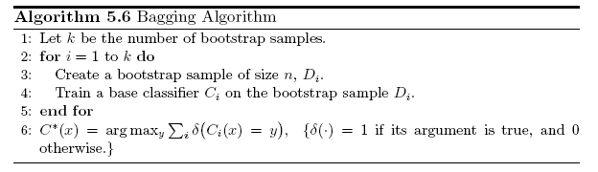
Bagging Algorithm
We can also use hash functions (of data sample id, tree id) to create random samples
https://people.csail.mit.edu/rivest/pubs/Riv18e.pdf

Slide 8
Bagging Example
Consider 1-dimensional data
Classifier is a decision stump
Decision rule: x ≤ k versus x > k
Split point k is chosen based on entropy
Decision stump is a weak learner
x ≤ k
True
False
y_{left}
y_{right}

Slide 9
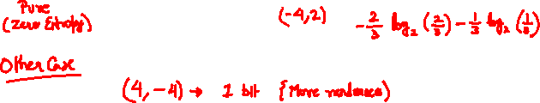
Example

Slide 10
Example Continued

Slide 11
Bagging Example

Slide 12
Example conclusion
Predicted Class
Assume test set is the same as the original data
Use majority vote to determine class of ensemble classifier

Slide 13
Random Forests
Extension of bagging of decision trees: generate bootstrap training samples, and a tree based on each, but also randomize subset of predictors (features) allowed each time a split is considered.
Typically, # of random predictors chosen to be of order the square root of the total number of predictors.
This is called: Feature bagging
Benefit: Breaks correlation between trees
If one feature is very strong predictor, then every tree will select it, causing trees to be correlated.
All trees are fully grown, No pruning
Two parameters
Number of trees
Number of features
Random Forests achieve state-of-the-art results in many classification problems!

Slide 14
Boosting: Learning from Mistakes
Boosting: Another ensemble learning algorithm
Combines the outputs of many “weak” classifiers to produce a powerful “committee”
Learns multiple trees sequentially, each trying to improve upon its predecessor
Adaptively change distribution of training data by focusing more on previously misclassified records
Initially, all N records are assigned equal weights
Unlike bagging, weights may change at the end of each boosting round
Final classifier is weighted sum of the individual classifiers

Slide 15
Examples of Boosting
AdaBoost : Where each 𝐺𝑡(𝑥)is a one–level decision tree
Gradient Boosted Decision Trees: Where each 𝐺𝑡(𝑥)is a multi–level decision tree
There are few implementations on boosting:
XGBoost: An efficient Gradient Boosting Decision
LGBM: Light Gradient Boosted Machines. It is a library for training GBMs developed by Microsoft, and it competes with XGBoost
CatBoost: A new library for Gradient Boosting Decision Trees, offering appropriate handling of categorical features

Slide 16
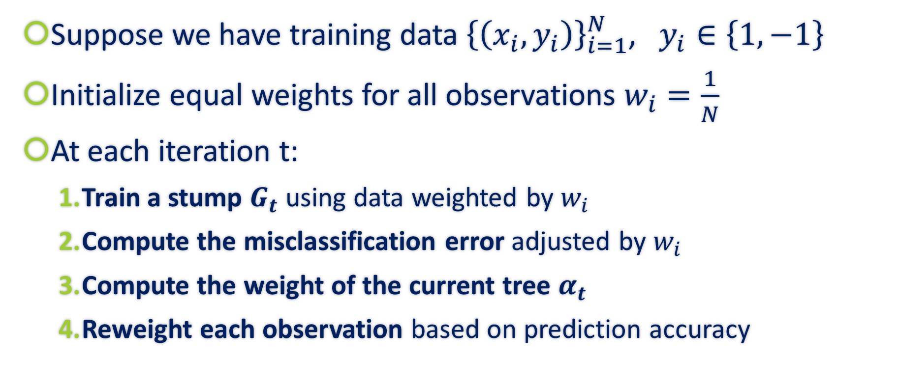
AdaBoost Procedure
Suppose we have training data ${\left\{\left(x_{i}, y_{i}\right)\right\}}_{i=1}^{N}$, $y_{i}∈\left\{1,−1\right\}$
Initialize equal weights for all observations $w_{i}=\frac{1}{N}$
At each iteration t:
Train a stump $G_{t}$ using data weighted by $w_{i}$
Compute the misclassification error adjusted by $w_{i}$
Compute the weight of the current tree $α_{t}$
Reweight each observation based on prediction accuracy

Slide 17
AdaBoost: Weak Learner
Records that are wrongly classified will have their weights increased
Records that are classified correctly will have their weights decreased
Example 4 is hard to classify
Its weight is increased, therefore it is more likely to be chosen again in subsequent rounds

Slide 18
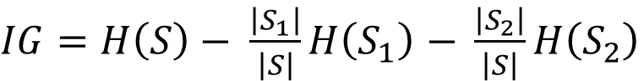
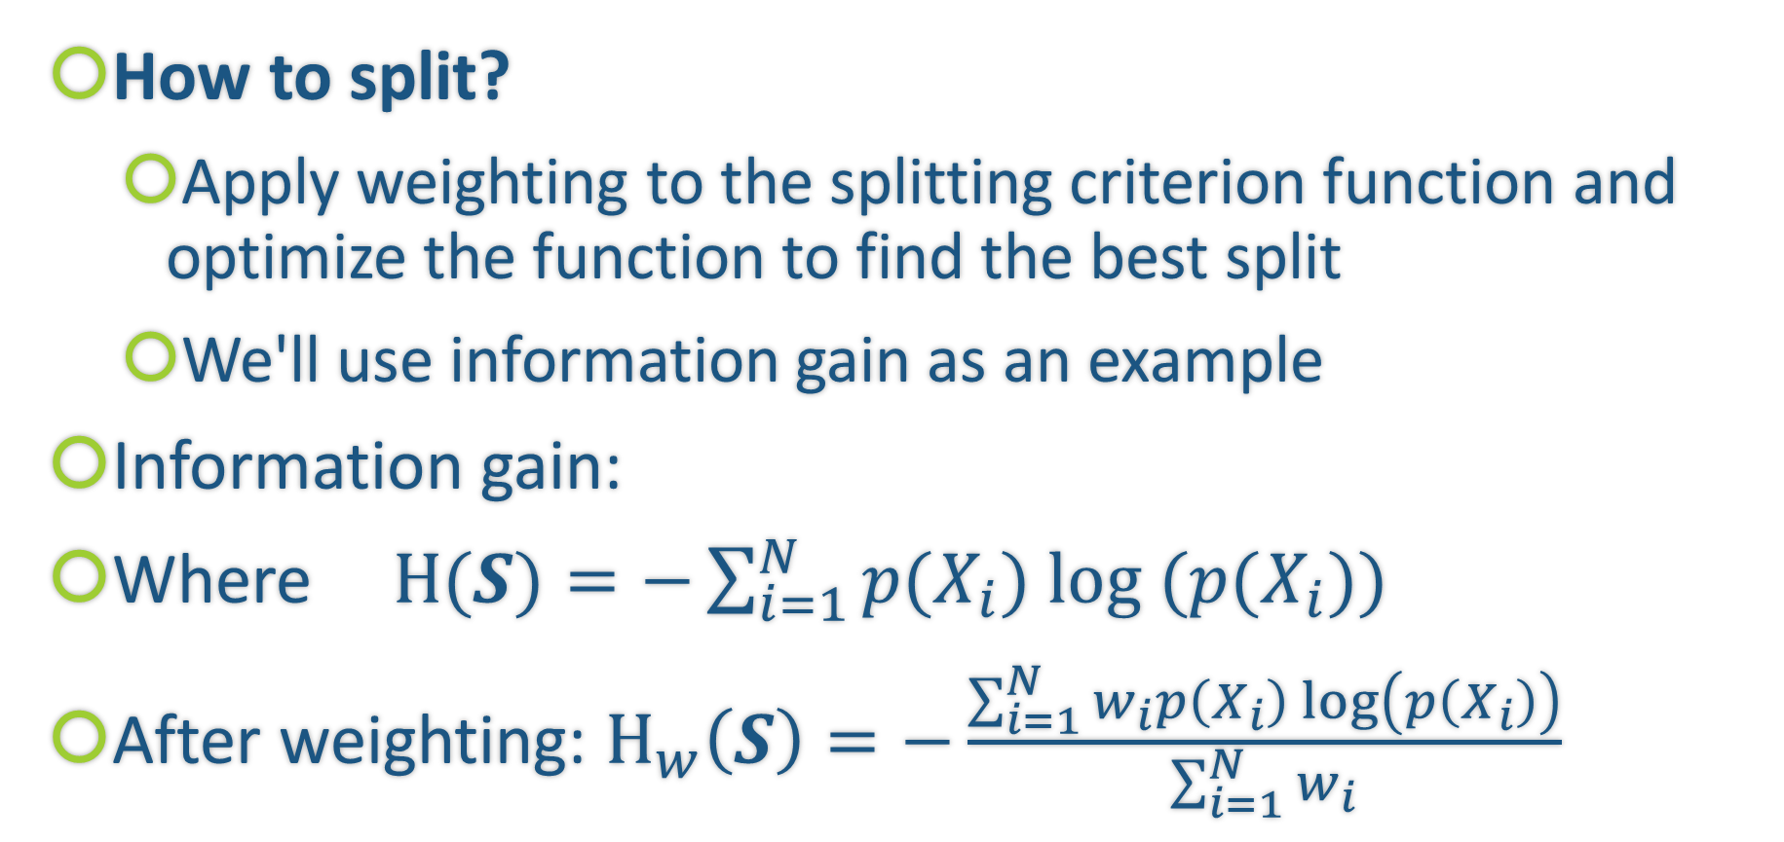
Training one decision tree
How to split?
Apply weighting to the splitting criterion function and optimize the function to find the best split
We'll use information gain as an example
Information gain:
Where$H(S)=−\sum_{i=1}^{N}{p(X_{i}) log (p(X_{i}))}$
After weighting: $H_{w}\left(S\right)=−\frac{\sum_{i=1}^{N}{w_{i}p\left(X_{i}\right)\log\left(p\left(X_{i}\right)\right)}}{\sum_{i=1}^{N}{w_{i}}}$
$IG=H\left(S\right)− \frac{\left|S_{1}\right|}{\left|S\right|}H\left(S_{1}\right)$ $− \frac{\left|S_{2}\right|}{\left|S\right|}H\left(S_{2}\right)$

Slide 19
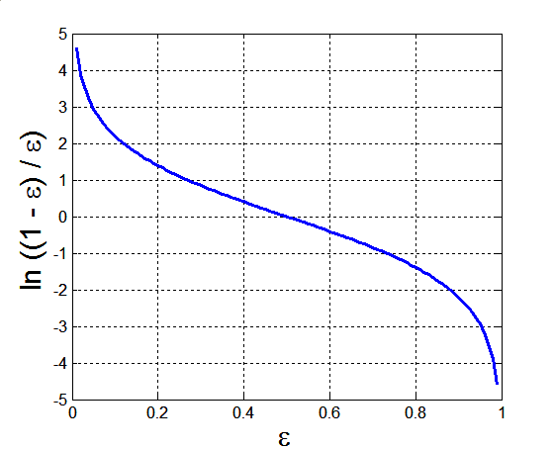

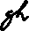
Ada Boost
Base classifiers: C₁, C₂, …, C_{T}
Calculate the weighted mis-classification error rate:
Use the error to weight the current tree in the final classifier:

Slide 20
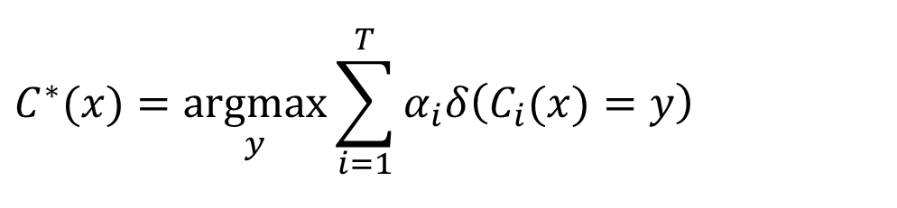
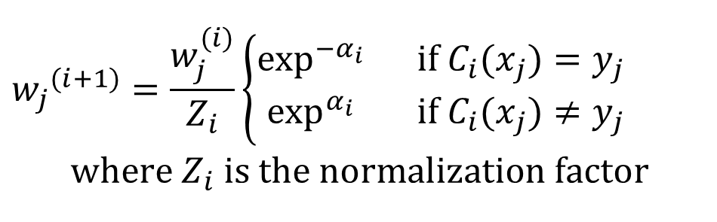
AdaBoost Algorithm Continued
$${w_{j}}^{(i+1)}=\frac{w_{j}^{(i)}}{Z_{i}}\left\{\begin{matrix}\exp^{−α_{i}}{ } & \text{if} C_{i}(x_{j})=y_{j} \\ \exp^{α_{i}}{ } & \text{if} C_{i}(x_{j})≠y_{j}\end{matrix}\right. \\ \text{where} Z_{i} \text{is} \text{the} \text{normalization} \text{factor}$$
Weight update of training data:
If any intermediate rounds produce error rate higher than 50%, the weights are reverted back to 1/n and the resampling procedure is repeated
Classification:
$$C^{∗}(x)=\underset{y}{argmax}\sum_{i=1}^{T}{α_{i}δ\left(C_{i}(x)=y\right)}$$

Slide 21
An Illustration
Misclassified points become more important in the next round
Together, simple classifiers can make complex decisions

Slide 22
AdaBoost Algorithm Summary

Slide 23
AdaBoost Example
Consider 1-dimensional data set:
Classifier is a decision stump
Decision rule: x ≤ k versus x > k
Split point k is chosen based on entropy
x ≤ k
True
False
y_{left}
y_{right}

Slide 24
AdaBoost Example
Training sets for the first 3 boosting rounds:
Summary:

Slide 25
AdaBoost Example
Weights
Classification
Predicted Class

Slide 26
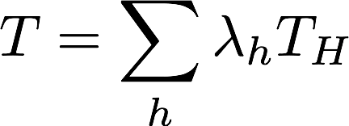
Gradient Boosting
Idea: Perform additive training with simple models {T_{h}}_{h∈H}
Add a new model (decision tree) each time
Here the model can be multi-level
Question: But which models should we include in our ensemble? What should the coefficients or weights in the linear combination be?

Slide 27
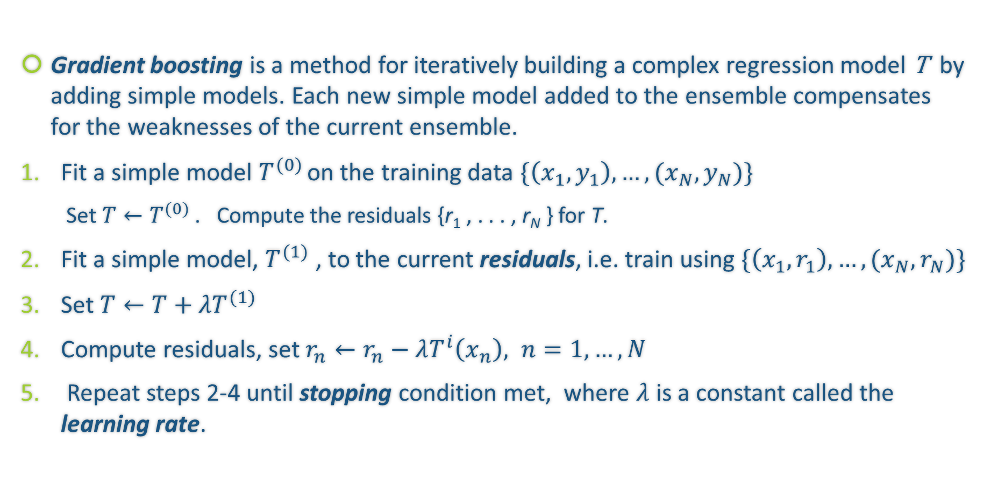
Gradient Boosting: the algorithm
Gradient boosting is a method for iteratively building a complex regression model T by adding simple models. Each new simple model added to the ensemble compensates for the weaknesses of the current ensemble.
Fit a simple model $T^{(0)}$ on the training data $\{\left(x_{1}, y_{1}\right),…,(x_{N},y_{N})\}$
Set$T←T^{(0)}$ . Compute the residuals {r₁ , . . . , r_{N} } for T.
Fit a simple model, $T^{(1)}$ , to the current residuals, i.e. train using $\{\left(x_{1}, r_{1}\right),…,(x_{N},r_{N})\}$
Set ${T←T+λT}^{(1)}$
Compute residuals, set $r_{n}←r_{n}−λT^{i}\left(x_{n}\right), n=1,…,N$
Repeat steps 2-4 until stopping condition met, where $λ$ is a constant called the learning rate.

Slide 28
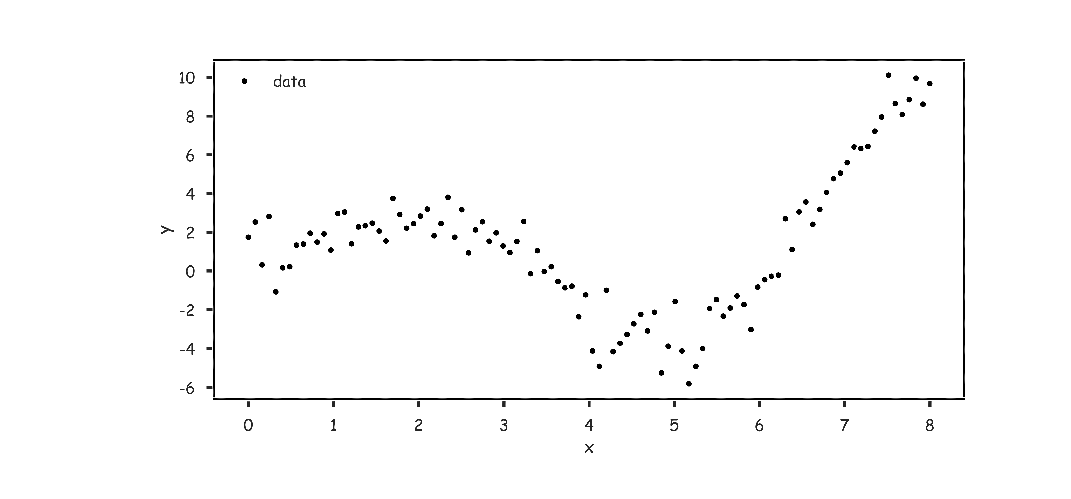
Gradient Boosting: illustration

Slide 29
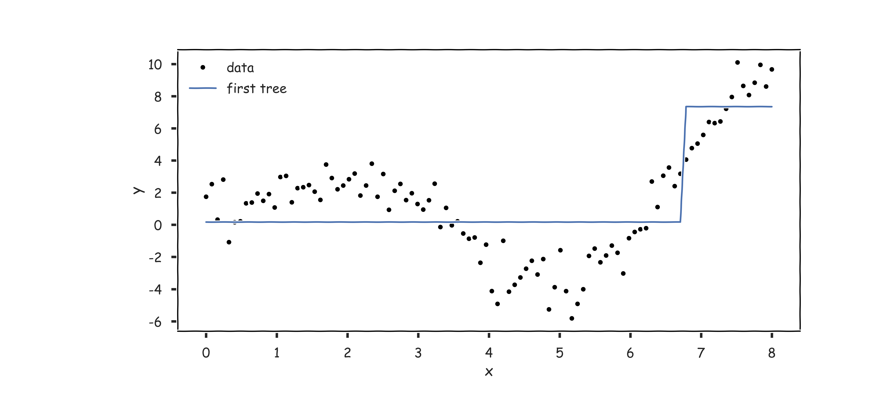
Gradient Boosting: illustration

Slide 30
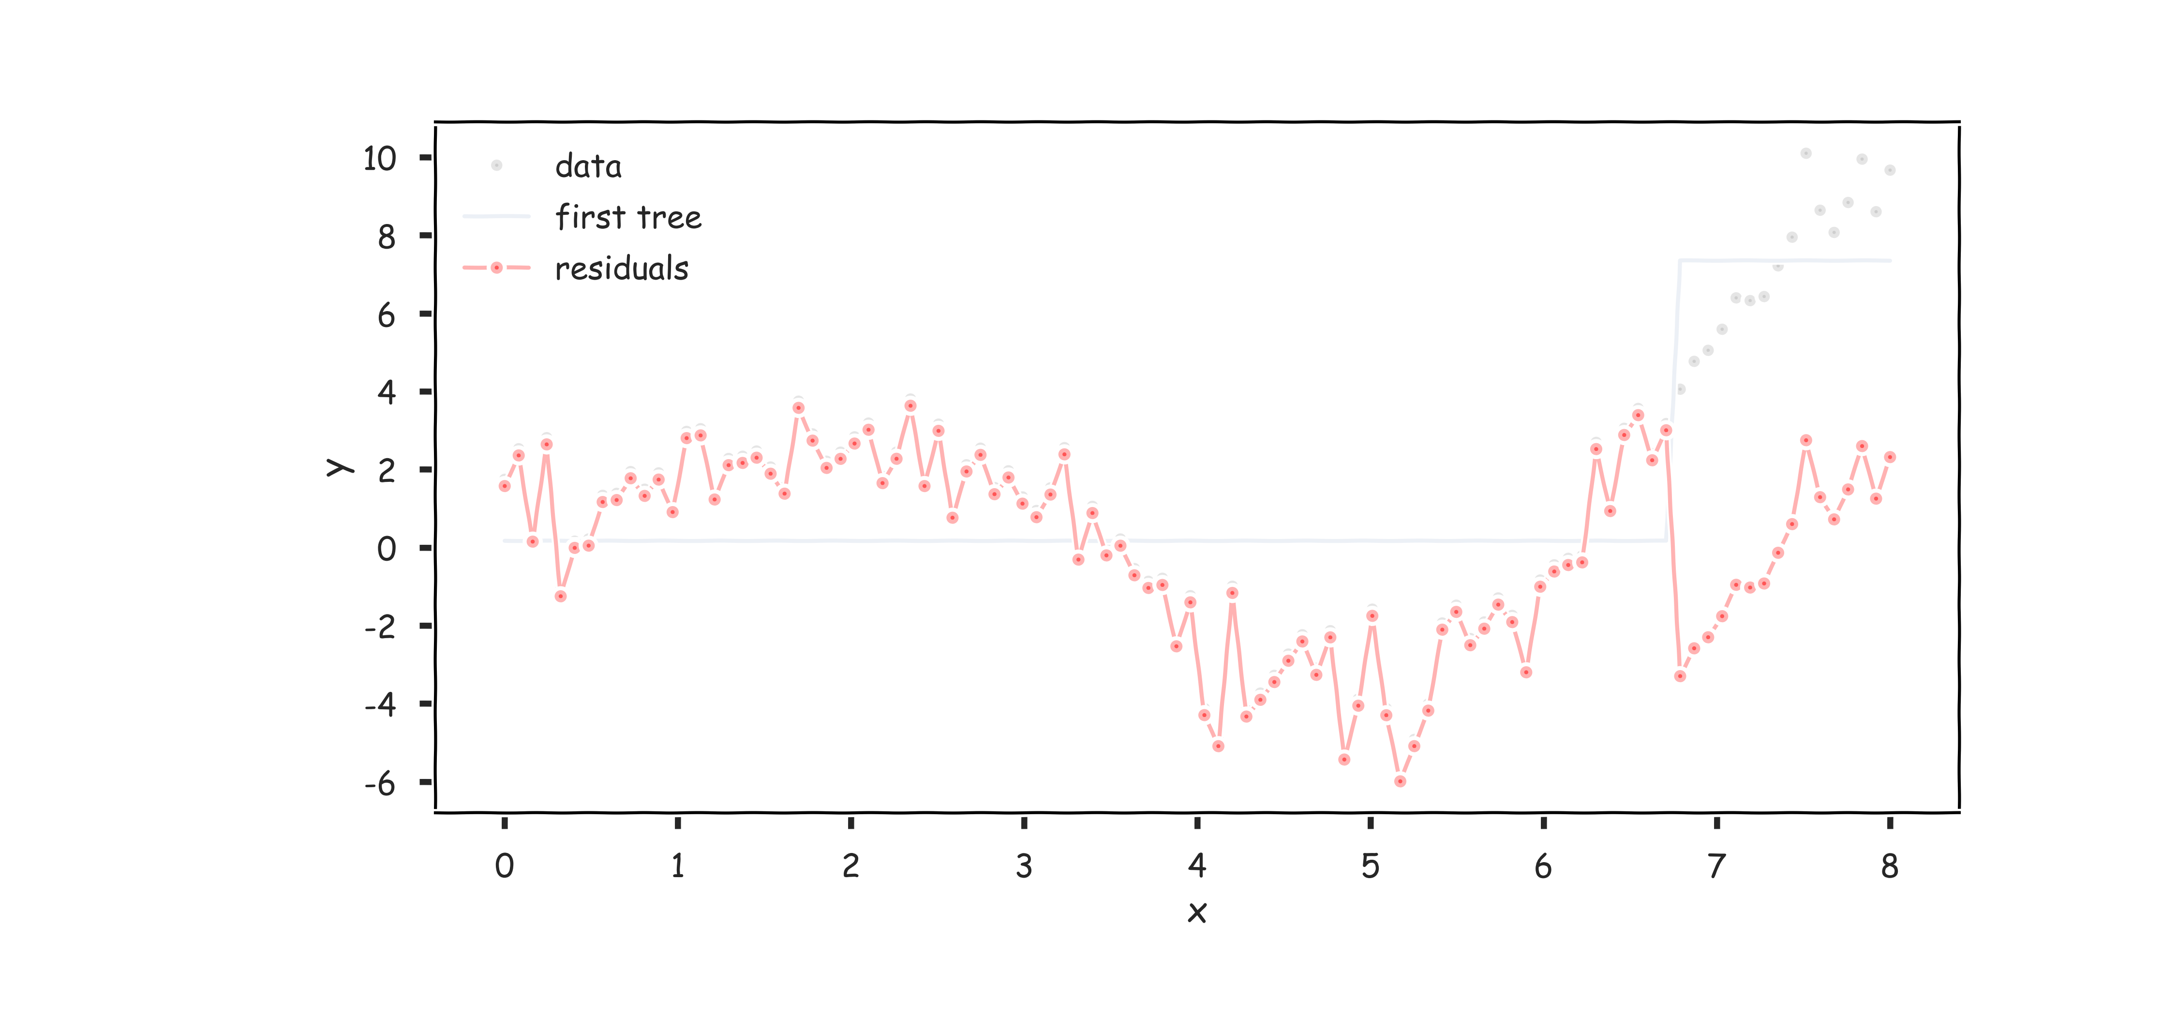
Gradient Boosting: illustration

Slide 31
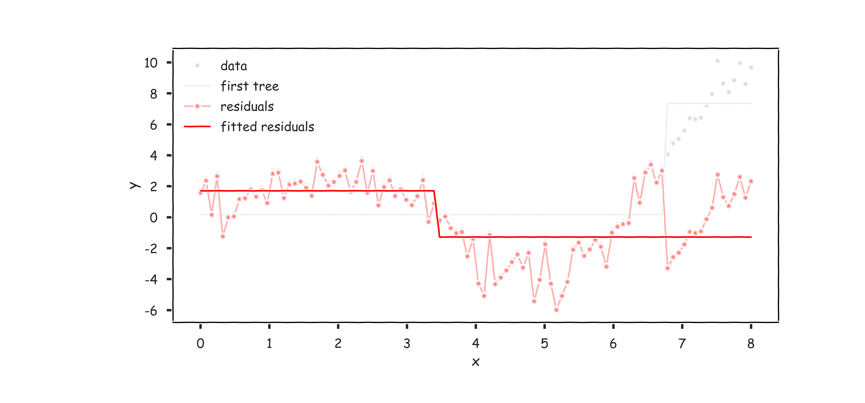
Gradient Boosting: illustration

Slide 32
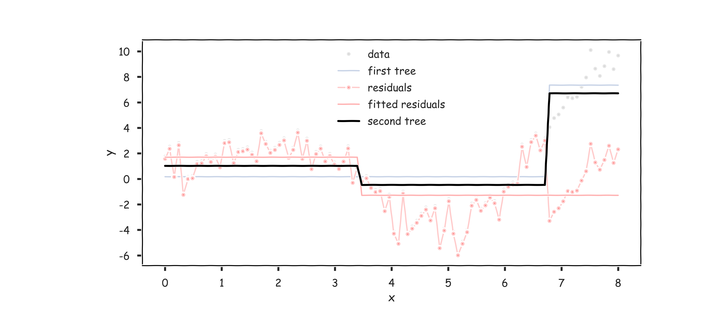
Gradient Boosting: illustration

Slide 33
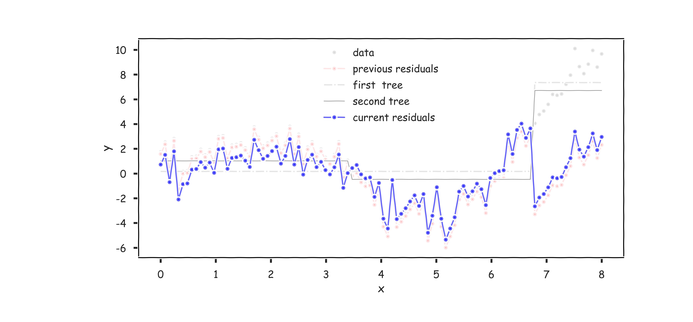
Gradient Boosting: illustration

Slide 34
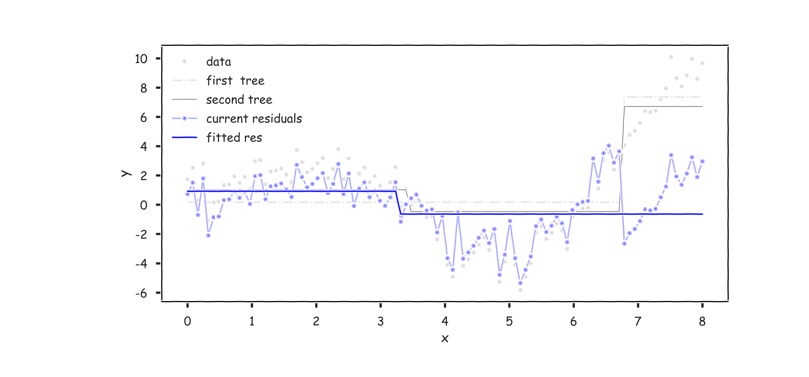
Gradient Boosting: illustration

Slide 35
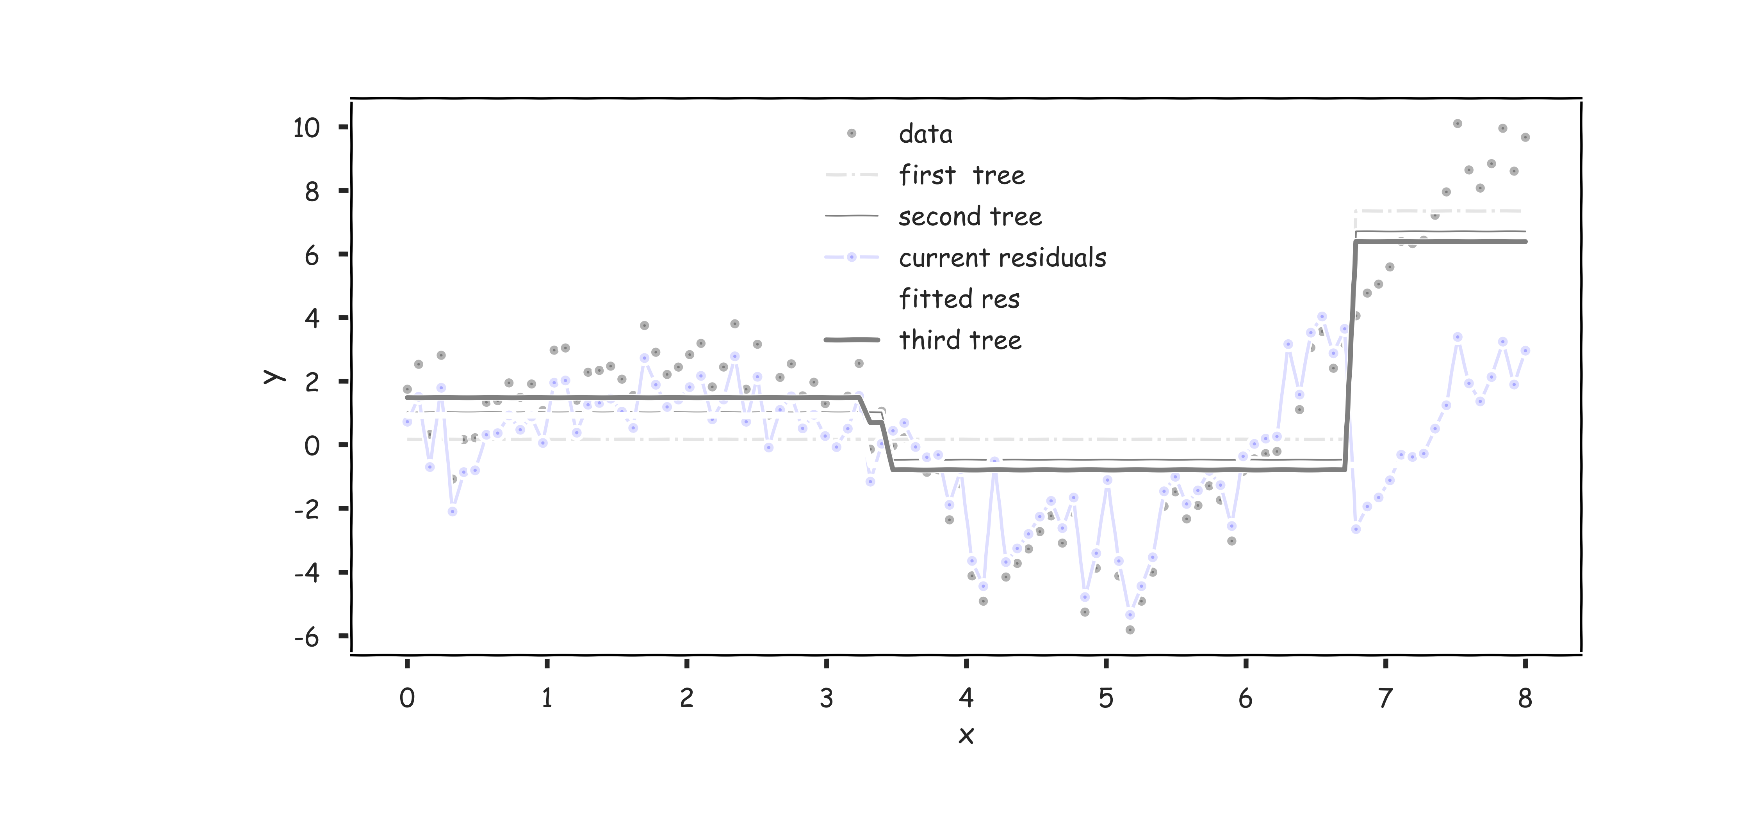
Gradient Boosting: illustration

Slide 36
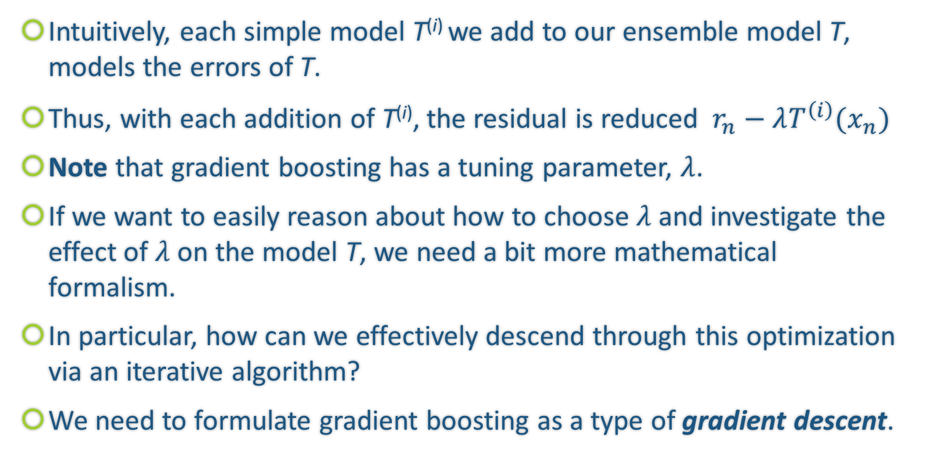
Why Does Gradient Boosting Work?
Intuitively, each simple model T^{(i)} we add to our ensemble model T, models the errors of T.
Thus, with each addition of T^{(i)}, the residual is reduced $r_{n}−λT^{\left(i\right)}(x_{n})$
Note that gradient boosting has a tuning parameter, $λ$.
If we want to easily reason about how to choose $λ$ and investigate the effect of $λ$ on the model T, we need a bit more mathematical formalism.
In particular, how can we effectively descend through this optimization via an iterative algorithm?
We need to formulate gradient boosting as a type of gradient descent.

Slide 37
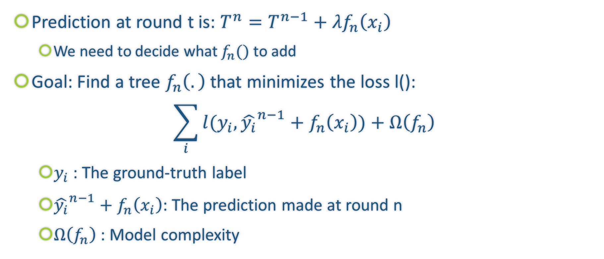
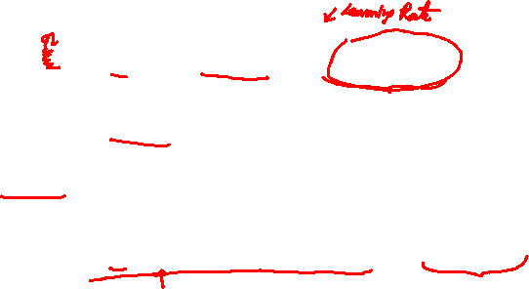
Gradient Boosting with Regularization
Prediction at round t is: $T^{n}=T^{n−1}+{λf}_{n}\left(x_{i}\right)$
We need to decide what $f_{n}()$ to add
Goal: Find a tree $f_{n}\left(.\right)$ that minimizes the loss l():
$$\sum_{i}{l(y_{i},{\hat{y_{i}}}^{n−1}+f_{n}\left(x_{i}\right))}+Ω\left(f_{n}\right)$$
$y_{i}$ : The ground-truth label
${\hat{y_{i}}}^{n−1}+f_{n}\left(x_{i}\right)$: The prediction made at round n
$Ω\left(f_{n}\right)$ : Model complexity

Slide 38
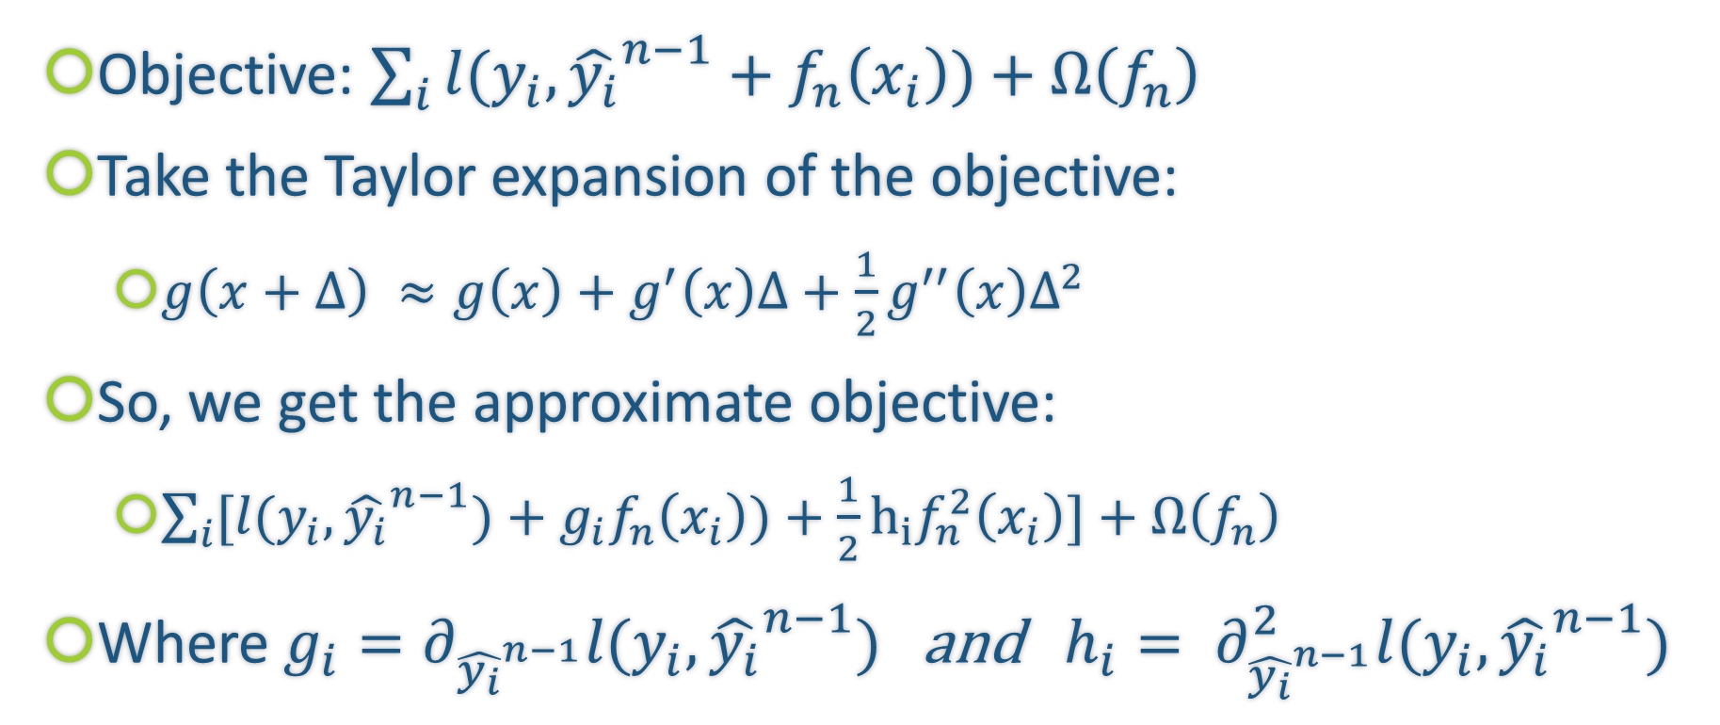

Regularized Gradient Boosting
Objective: $\sum_{i}{l(y_{i},{\hat{y_{i}}}^{n−1}+f_{n}\left(x_{i}\right))}+Ω\left(f_{n}\right)$
Take the Taylor expansion of the objective:
$g\left(x+Δ\right) ≈g\left(x\right)+g^{′}\left(x\right)Δ+\frac{1}{2}g^{′′}\left(x\right)Δ^{2}$
So, we get the approximate objective:
$\sum_{i}{[l(y_{i},{\hat{y_{i}}}^{n−1})+g_{i}f_{n}\left(x_{i}\right))}+\frac{1}{2}h_{i}f_{n}^{2}\left(x_{i}\right)]+Ω\left(f_{n}\right)$
Where $g_{i}=∂_{{\hat{y_{i}}}^{n−1}}l(y_{i},{\hat{y_{i}}}^{n−1})$ and $h_{i}= ∂_{{\hat{y_{i}}}^{n−1}}^{2}l(y_{i},{\hat{y_{i}}}^{n−1})$

Slide 39

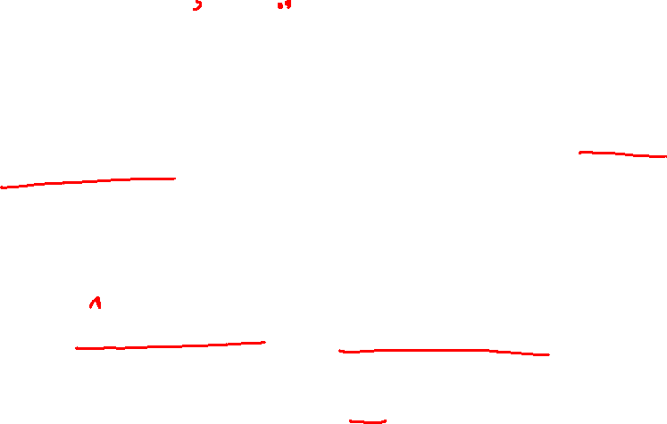

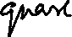



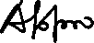

How to decide which f to add?

Slide 40



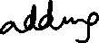



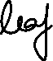




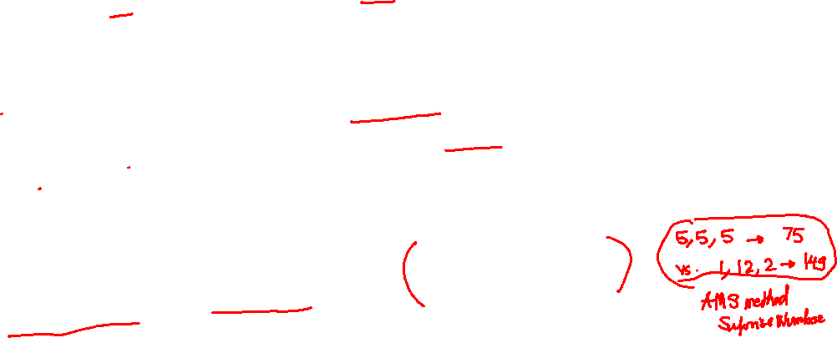





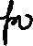






Model Complexity

Slide 41








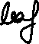













Reordering the objective

Slide 42
















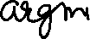


Finding optimal $w_{j}^{∗}$

Slide 43






Greedy solution
In practice, we grow tree greedily:
Start with tree with depth 0
For each leaf node in the tree, try to add a split
The change of the objective after adding a split is:
Take the split that gives the best gain.

Slide 44

Summary: GBDT Algorithm

Slide 45
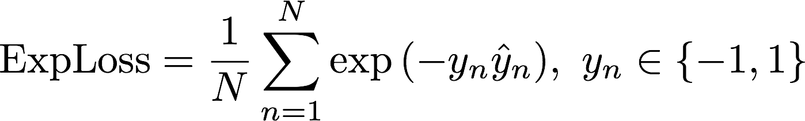
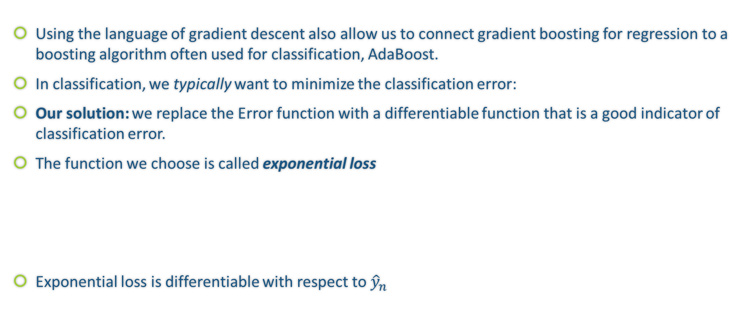
AdaBoost and Gradient Boosting
Using the language of gradient descent also allow us to connect gradient boosting for regression to a boosting algorithm often used for classification, AdaBoost.
In classification, we typically want to minimize the classification error:
Our solution: we replace the Error function with a differentiable function that is a good indicator of classification error.
The function we choose is called exponential loss
Exponential loss is differentiable with respect to ${\hat{y}}_{n}$

Slide 46
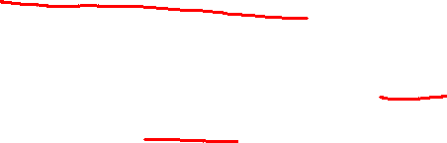
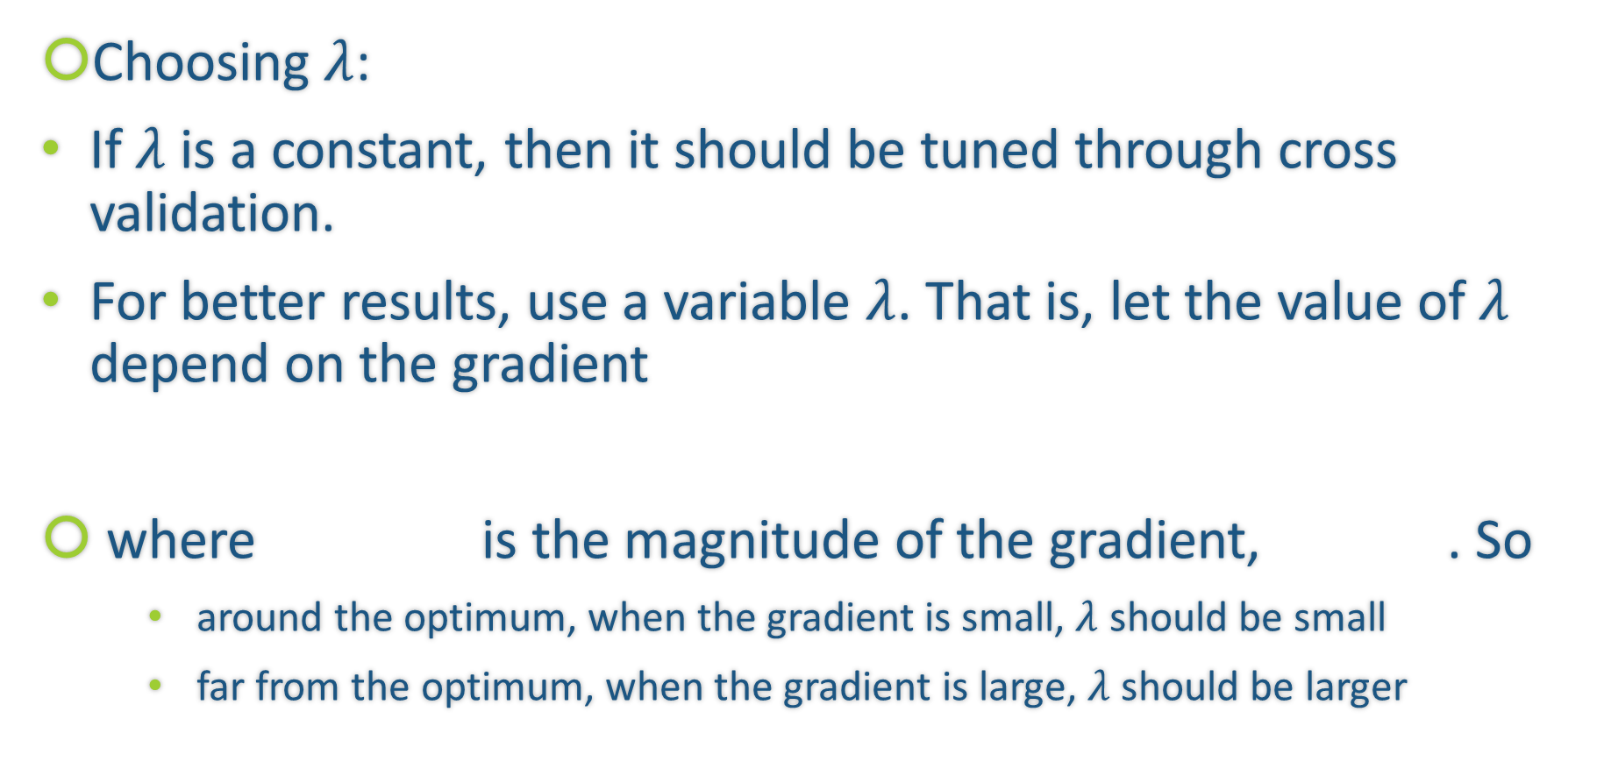
Choosing a Learning Rate
Choosing $λ$:
If $λ$ is a constant, then it should be tuned through cross validation.
For better results, use a variable $λ$. That is, let the value of $λ$ depend on the gradient
where is the magnitude of the gradient, . So
around the optimum, when the gradient is small, $λ$ should be small
far from the optimum, when the gradient is large, $λ$ should be larger

Slide 47
Review: A Brief Sketch of Gradient Descent
In optimization, when we wish to minimize a function, called the objective function, over a set of variables, we compute the partial derivatives of this function with respect to the variables.
If the partial derivatives are sufficiently simple, one can analytically find a common root - i.e. a point at which all the partial derivatives vanish; this is called a stationary point.
If the objective function has the property of being convex, then the stationary point is precisely the min.

Slide 48
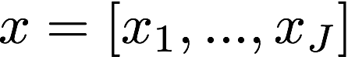
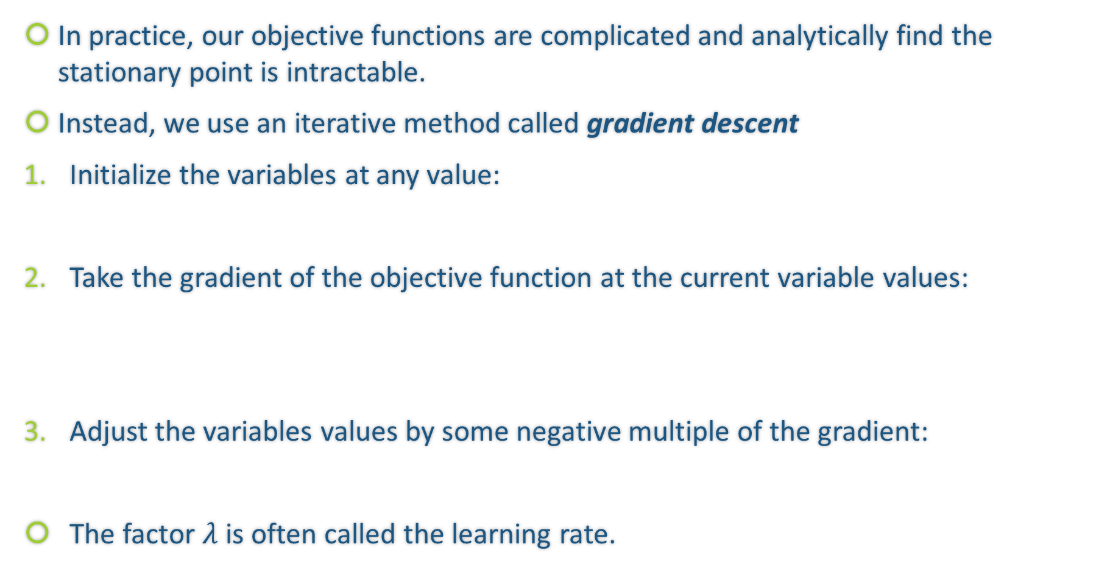
Review: A Brief Sketch of Gradient Descent Algorithm
In practice, our objective functions are complicated and analytically find the stationary point is intractable.
Instead, we use an iterative method called gradient descent
Initialize the variables at any value:
Take the gradient of the objective function at the current variable values:
Adjust the variables values by some negative multiple of the gradient:
The factor $λ$ is often called the learning rate.

Slide 49
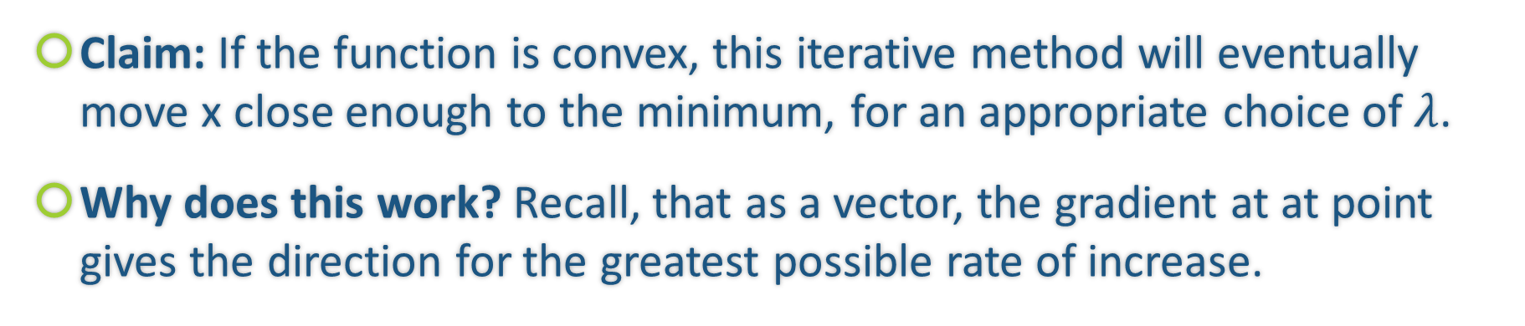
Why Does Gradient Descent Work?
Claim: If the function is convex, this iterative method will eventually move x close enough to the minimum, for an appropriate choice of $λ$.
Why does this work? Recall, that as a vector, the gradient at at point gives the direction for the greatest possible rate of increase.

Slide 50
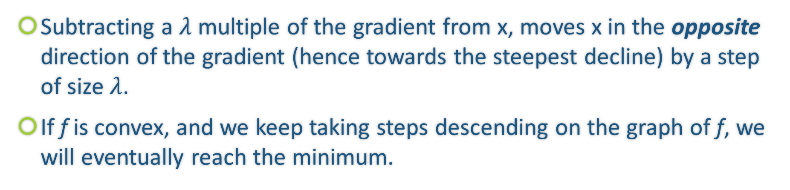
Why Does Gradient Descent Work?
Subtracting a $λ$ multiple of the gradient from x, moves x in the opposite direction of the gradient (hence towards the steepest decline) by a step of size $λ$.
If f is convex, and we keep taking steps descending on the graph of f, we will eventually reach the minimum.

Slide 51
Gradient Boosting as Gradient Descent
Often in regression, our objective is to minimize the MSE
Treating this as an optimization problem, we can try to directly minimize the MSE with respect to the predictions
The update step for gradient descent would look like

Slide 52
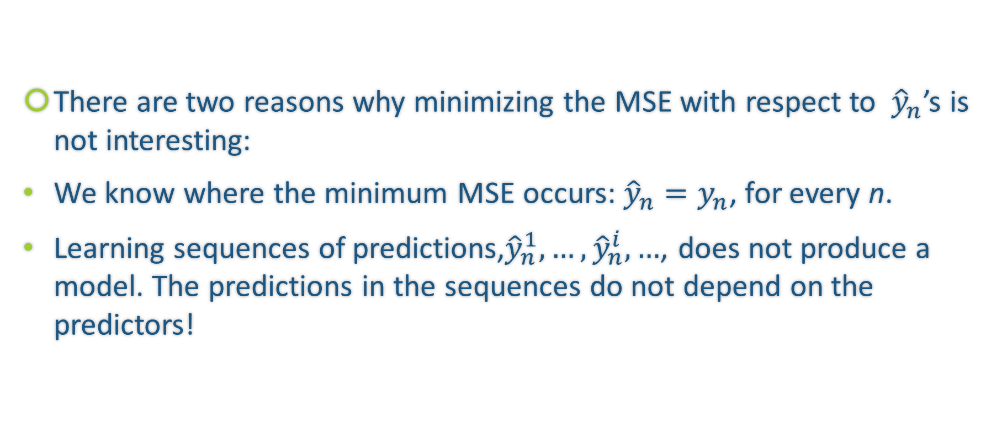
Gradient Boosting as Gradient Descent (cont.)
There are two reasons why minimizing the MSE with respect to ${\hat{y}}_{n}$’s is not interesting:
We know where the minimum MSE occurs: ${\hat{y}}_{n}=y_{n}$, for every n.
Learning sequences of predictions,${\hat{y}}_{n}^{1},…,{\hat{y}}_{n}^{i},…$, does not produce a model. The predictions in the sequences do not depend on the predictors!

Slide 53
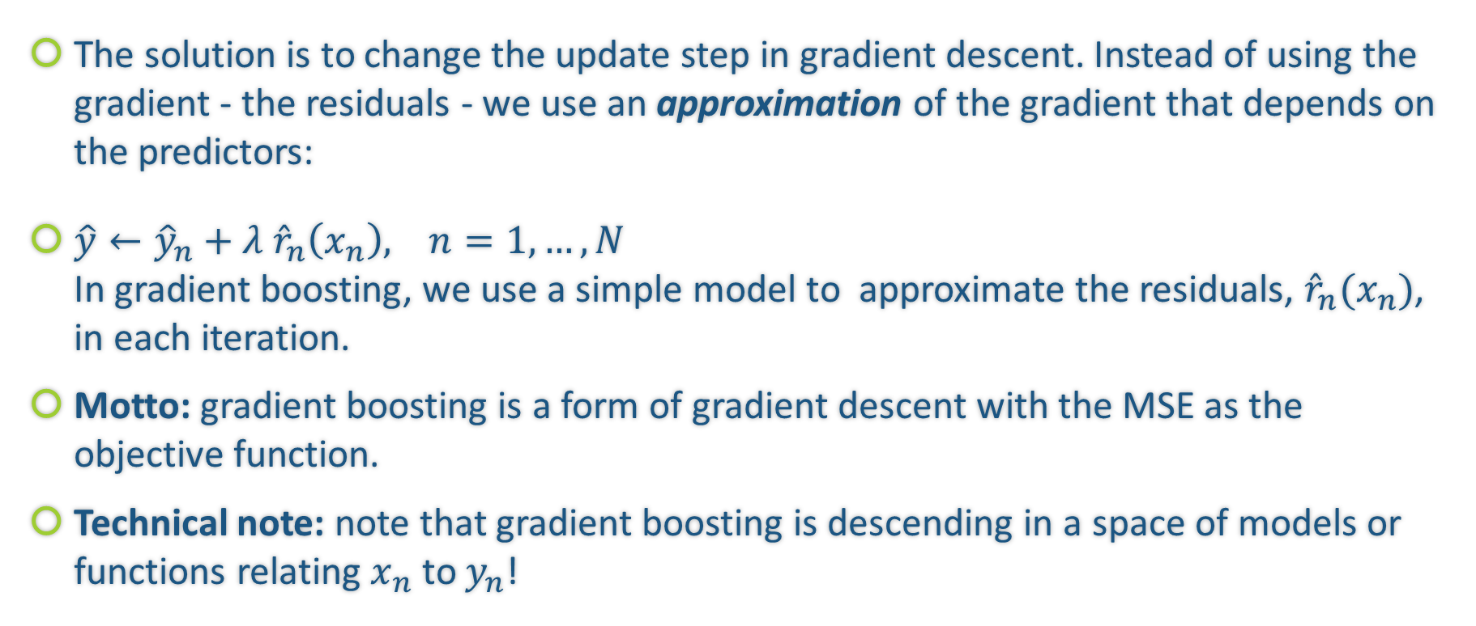
Gradient Boosting as Gradient Descent (cont.)
The solution is to change the update step in gradient descent. Instead of using the gradient - the residuals - we use an approximation of the gradient that depends on the predictors:
$\hat{y}←{\hat{y}}_{n}+λ {\hat{r}}_{n}\left(x_{n}\right), n=1,…,N$ In gradient boosting, we use a simple model to approximate the residuals, ${{\hat{r}}_{n}(x}_{n})$, in each iteration.
Motto: gradient boosting is a form of gradient descent with the MSE as the objective function.
Technical note: note that gradient boosting is descending in a space of models or functions relating $x_{n}$ to $y_{n}$!

Slide 54
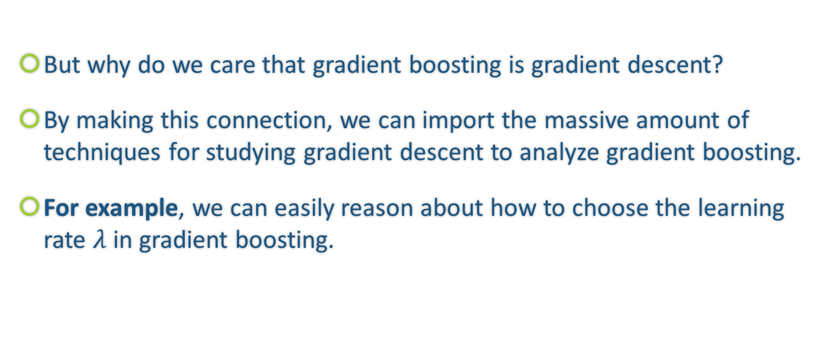
Gradient Boosting as Gradient Descent (cont.)
But why do we care that gradient boosting is gradient descent?
By making this connection, we can import the massive amount of techniques for studying gradient descent to analyze gradient boosting.
For example, we can easily reason about how to choose the learning rate $λ$ in gradient boosting.

Slide 55
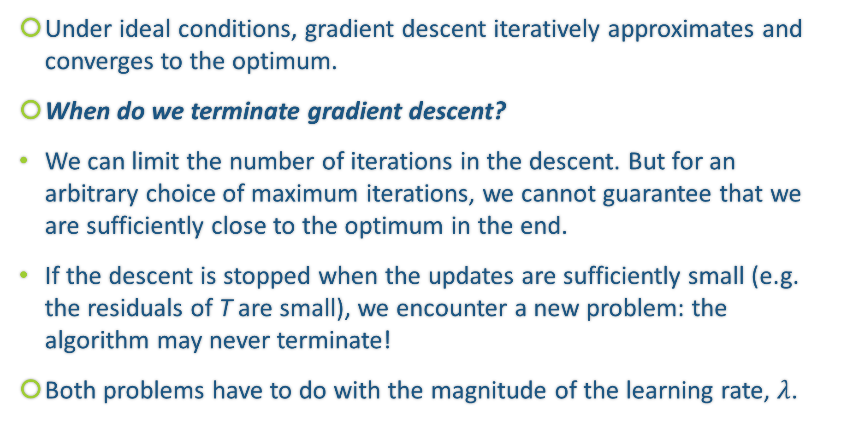
Choosing a Learning Rate
Under ideal conditions, gradient descent iteratively approximates and converges to the optimum.
When do we terminate gradient descent?
We can limit the number of iterations in the descent. But for an arbitrary choice of maximum iterations, we cannot guarantee that we are sufficiently close to the optimum in the end.
If the descent is stopped when the updates are sufficiently small (e.g. the residuals of T are small), we encounter a new problem: the algorithm may never terminate!
Both problems have to do with the magnitude of the learning rate, $λ$.

Slide 56
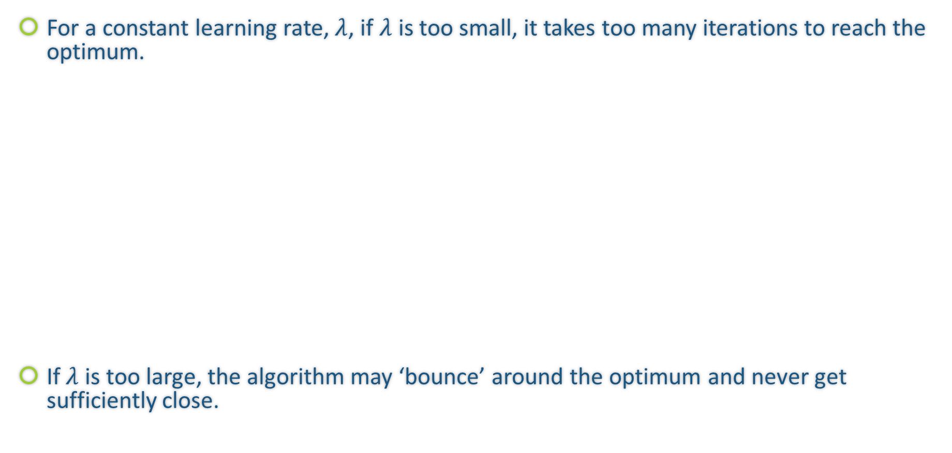
Choosing a Learning Rate
For a constant learning rate, $λ$, if $λ$ is too small, it takes too many iterations to reach the optimum.
If $λ$ is too large, the algorithm may ‘bounce’ around the optimum and never get sufficiently close.

